Slide 1

Market Perception of Banks in New York
Oscar J. Urizar November 1, 2020

Slide 2

Introduction
Retail banking remains a highly competitive business, with banks aiming to gain any edge on the competition. Although several services are conducted online, many other services are provided to customers at office branches. The perception of customers towards their bank is highly important in assessing the performance of banks around cities where they operate in order to plan future improvements. We propose a project to gain insights in the market perception of major banks in New York by performing a sentiment analysis on the text feedback provided by customers visiting various banks of this branch.

Slide 3

Data Acquisition and Preprocessing
For this project we are required to find the location of office branches of the various banks operating in New York. Furthermore, we need text feedback/reviews from people who have visited these venues. In summary we require two main data components:
Location of office branches
Text reviews from customers

Slide 4

Data Source
The data provider FourSquare contains a robust database covering the requirements for this project. Firstly, It provides data of multiple types of venues, including banks. Secondly, It also provides tips as plain text provided from people who have actually visited these venues.

Slide 5
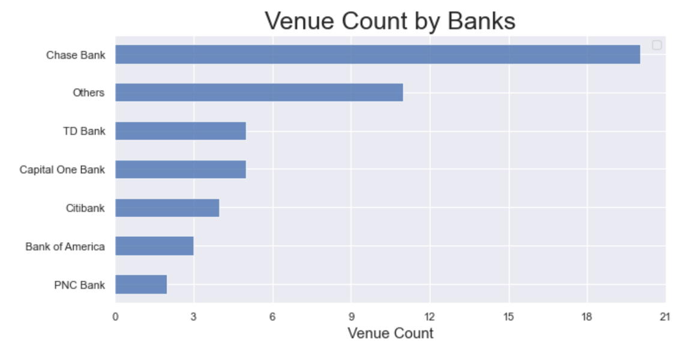
Exploratory Analysis
From the data available, 6 major banks are identified, whereas other banks with minimum presence are grouped into a single category labeled ‘Others’. The predominant banks are Chase Bank, TD Bank, and Capital One Bank.

Slide 6
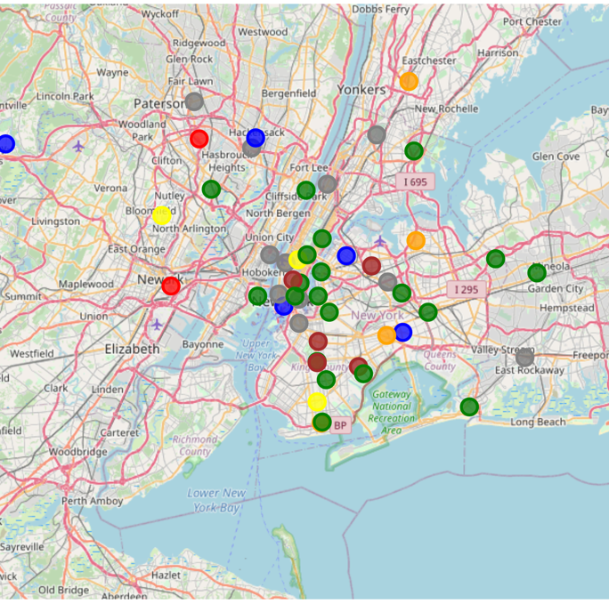
Exploratory Analysis
The venues obtained for each bank appear to be reasonably spread across the city of New York, positively impacting the sample significance with relation to the territory covered. We can visually confirm this in the plot below

Slide 7
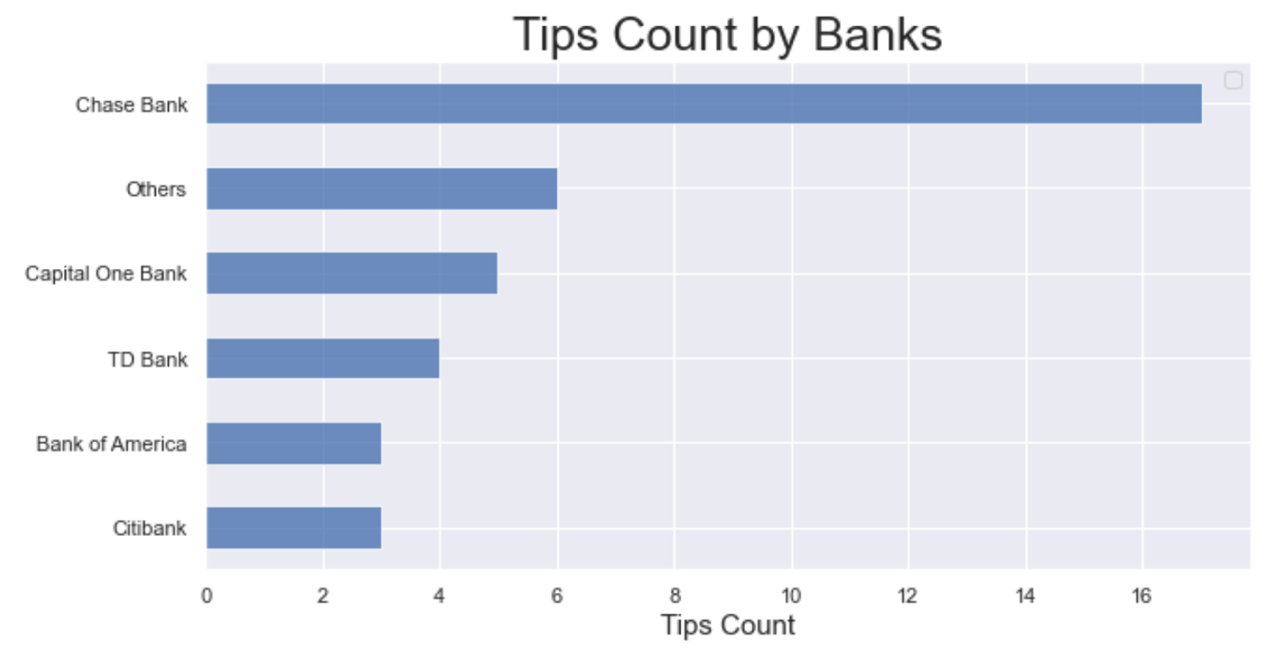
Exploratory Analysis
The data collected for both venues and tips is limited, not necessarily due to unavailability but rather to the constrains of the FourSquare account type used for this project.
From the data available, 6 major banks are identified, whereas other banks with minimum presence are grouped into a single category labeled ‘Others’. The predominant banks are Chase Bank, TD Bank, and Capital One Bank.

Slide 8
Sentiment Analysis
Sentiment analysis refers to the use of natural language processing, text analysis, computational linguistics, and biometrics to systematically identify, extract, quantify, and study affective states and subjective information.
Applied to this project we make use of the customer’s feedback voiced via tips in the FourSquare database. A score is to be computed for each tip in order to asses the subjective affective impression of customers.

Slide 9
Sentiment Analysis
Sentiment analysis refers to the use of natural language processing, text analysis, computational linguistics, and biometrics to systematically identify, extract, quantify, and study affective states and subjective information.
Applied to this project we make use of the customer’s feedback voiced via tips in the FourSquare database. A score is to be computed for each tip in order to asses the subjective affective impression of customers.

Slide 10
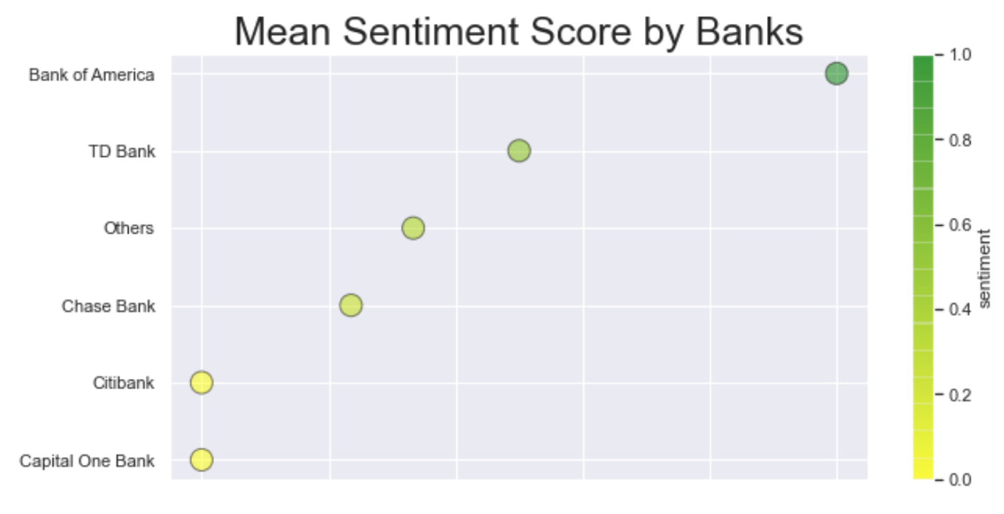
Results
Based on the collected data, Bank of America has a mean sentiment score of 1, placing it as the bank with best market perception in New York. This comes with the caveat that Bank of America is at the bottom half in number of venues and number of tips provided by customers. In short the reported market perception for Bank of America is positve but very representative due to the low amount of data available for this bank
Chase Bank has the most venues and tips, making its sentiment score the most significant to report. Their sentiment score is at 0.23, a score slighly above neutral.
None of the evaluated banks report a negative market perception. However the results are not statistically significant due to the modest volume of data available.

Slide 11
Discussion
This approach is a viable way to gain insights into the market perception of banks in any given location, given that sufficient data is collected.
It is important to mention that financial services are increasingly been provided online, hence this project covers only the market perception of customers visiting physical locations.

Slide 12
Conclusion
Provided the enough data with acceptable quality. Approaches of this nature are a powerful way to obtain insights into market percetion of companies

